Slide 1
Disclaimer
This training resource was developed to be used with the CZ ID platform
In October, 2026, stewardship of CZ ID transitioned to UCSF and the platform was renamed to SeqtoID
These training materials are not being actively maintained and may not reflect differences between CZ ID and SeqtoID, subsequent changes to the platform, or current methods and best practices in metagenomic sequencing and analysis

Slide 2
Prepare ONT fastq files for upload to CZID
(Concatenate and barcode filter)
Rapid Response – Updated Sept 2026

Slide 3
What is covered in this section?
Barcode trimming
FASTQ concatenation
Midread barcode trimming
FASTQ upload to CZ ID
Appendix: FASTQ concatenation aid

Slide 4
Barcodes need to be trimmed from all FASTQ’s prior to analysis
Barcodes are synthetic sequences that aid in the generation, sequencing, and demultiplexing of libraries. They are not part of your real sample
Therefore, we do not want to include barcode sequences in our data used for analysis
How is this done?
After demultiplexing is completed, barcodes should be trimmed. Some versions of MinKNOW have options to perform barcode trimming. Other tools like Dorado and Porechop used on the command line are also available
Notes:
Clean this slide up

Slide 5
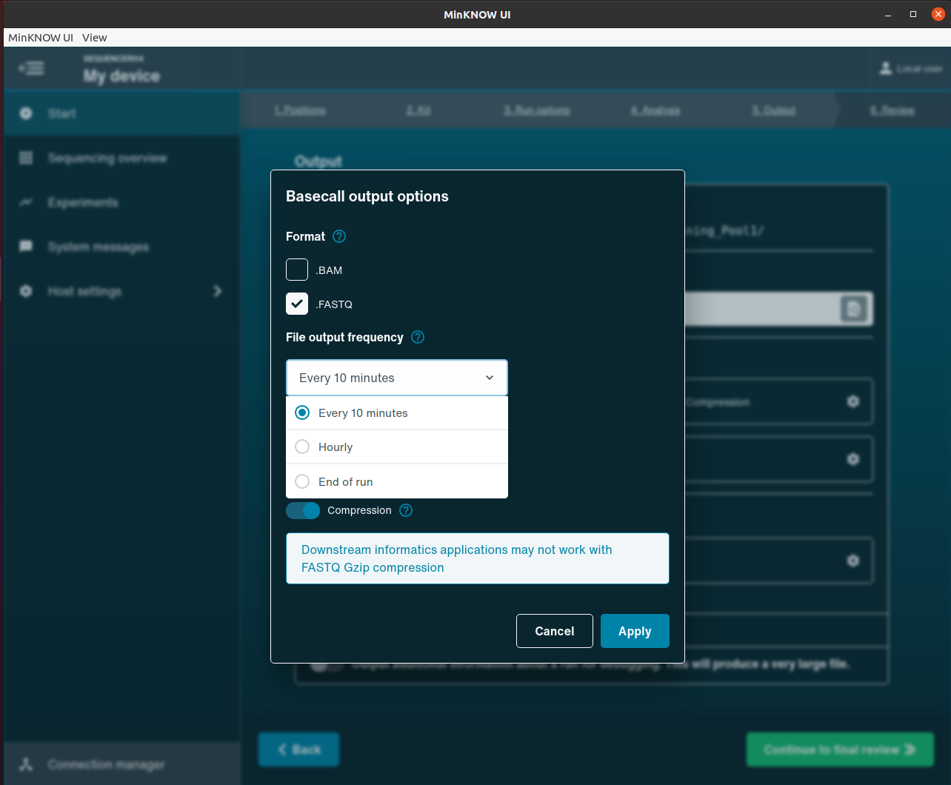
FASTQ file concatenation needs to be completed before CZID because…
FASTQ’s are generated every 10min per sample in most ONT runs
CZID has a limit on the number of FASTQ files that can be uploaded
Notes:
Clean this slide up

Slide 6
Prepare files for upload to CZ ID: concatenate
The multiple fastq files per sample need to be concatenated and renamed according to sample name
This is most easily completed on the command line
Note: CZ ID sample names are derived from the FASTQ file names, so it’s important for these to be intentional!
CZ ID help desk: Upload Nanopore Data
CZ ID help desk: Concatenate Sequence Files
  A concatenation support workbook is outlined in the appendix of this slide deck

Slide 7
FASTQ files need to be filtered to remove reads with \ midread barcodes before CZID because…
What is barcode bleeding?
Unintended misassignment of reads from one sample to another sample
How does this happen?
“Free barcodes from samples with a low amount of DNA molecules might ligate to non-barcoded DNA from samples with a highly overloaded number of molecules” or “short molecules passing through pore consecutively and interpreted as one read”
What will barcode bleeding look like?
False positive signal of a taxa that is present (likely at high levels) in another sample
What does this mean for my run?
Include water controls - these should help estimate barcode bleeding
https://www.frontiersin.org/journals/genetics/articles/10.3389/fgene.2021.711437/full
Notes:
Clean this slide up

Slide 8
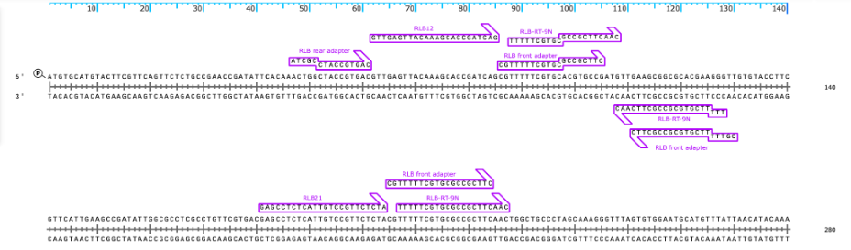
Observed patterns of barcode bleeding
More likely to happen when one sample in pool has a highly abundant target
More likely to happen when one sample in pool has short library fragments (200-300bp or less)
Anatomy of a barcode bleed read:
Barcode sequence detected in the middle of the read

Slide 9
Prepare files for upload to CZ ID: midread barcode filter
We created an online app to detect and discard reads that have a second barcode detected in the middle of the read
The midread barcode filter app is intended for FASTQ files that have already had adapters trimmed (usually completed in MinKNOW or using Dorado or Porechop)
Access and use here: https://github.com/gowtham-thakku/barcode-trimmer

Slide 10
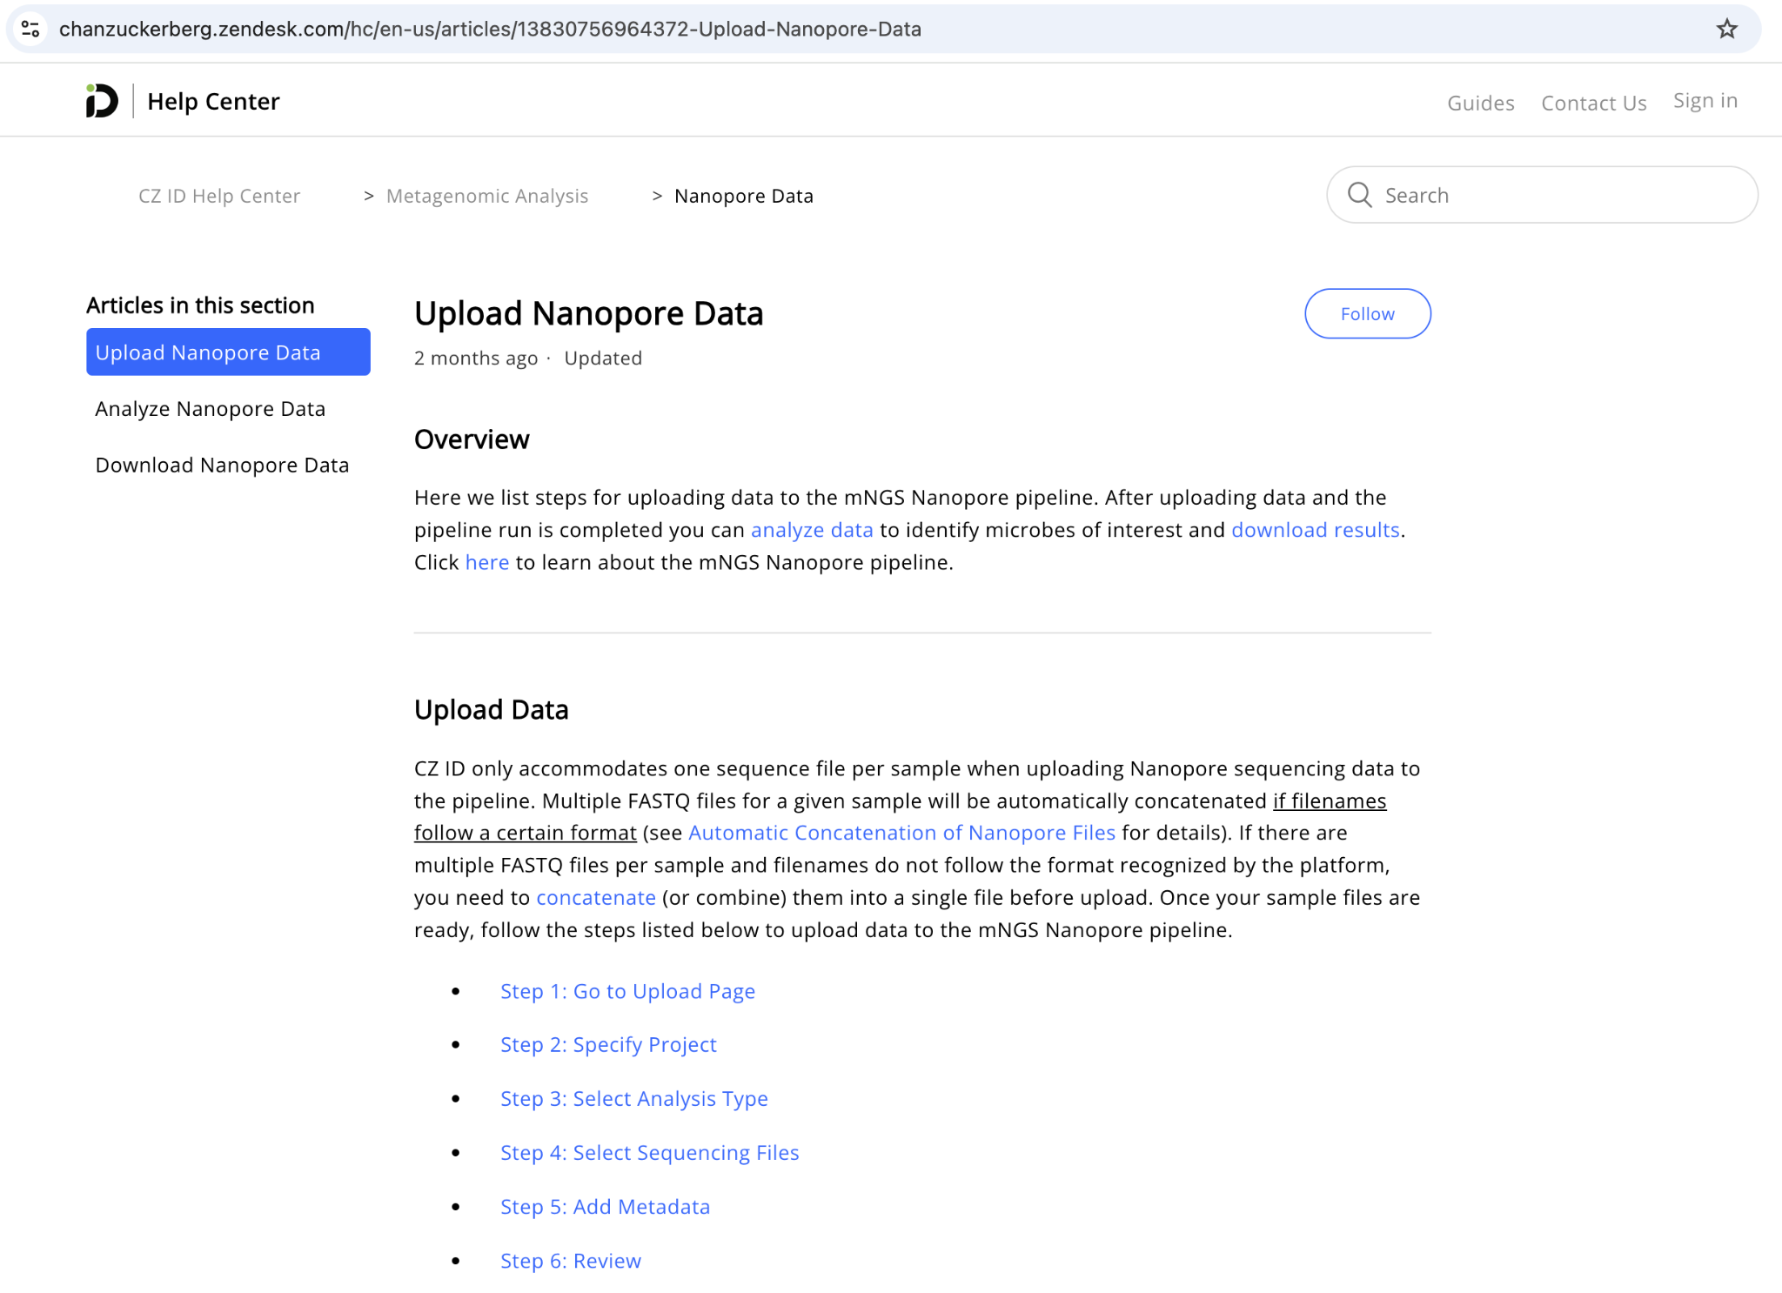
Upload your data to CZ ID
After these steps are completed, you are ready to upload to CZ ID!
Barcode trimming
FASTQ concatenation
Midread barcode filtering
CZ ID Guide to Upload Nanopore Data

Slide 11
FASTQ concatenation aid

Slide 12
Steps
Use worksheet to generate commands that will be needed to concatenate and rename fastq files
  Download Worksheet: ONT concat fastq worksheet_excelonly.xlsx
Locate the run output folder containing your data on your computer
Navigate to correct location in Command Prompt (Windows) or Terminal (Mac)
Run concatenation commands

Slide 13
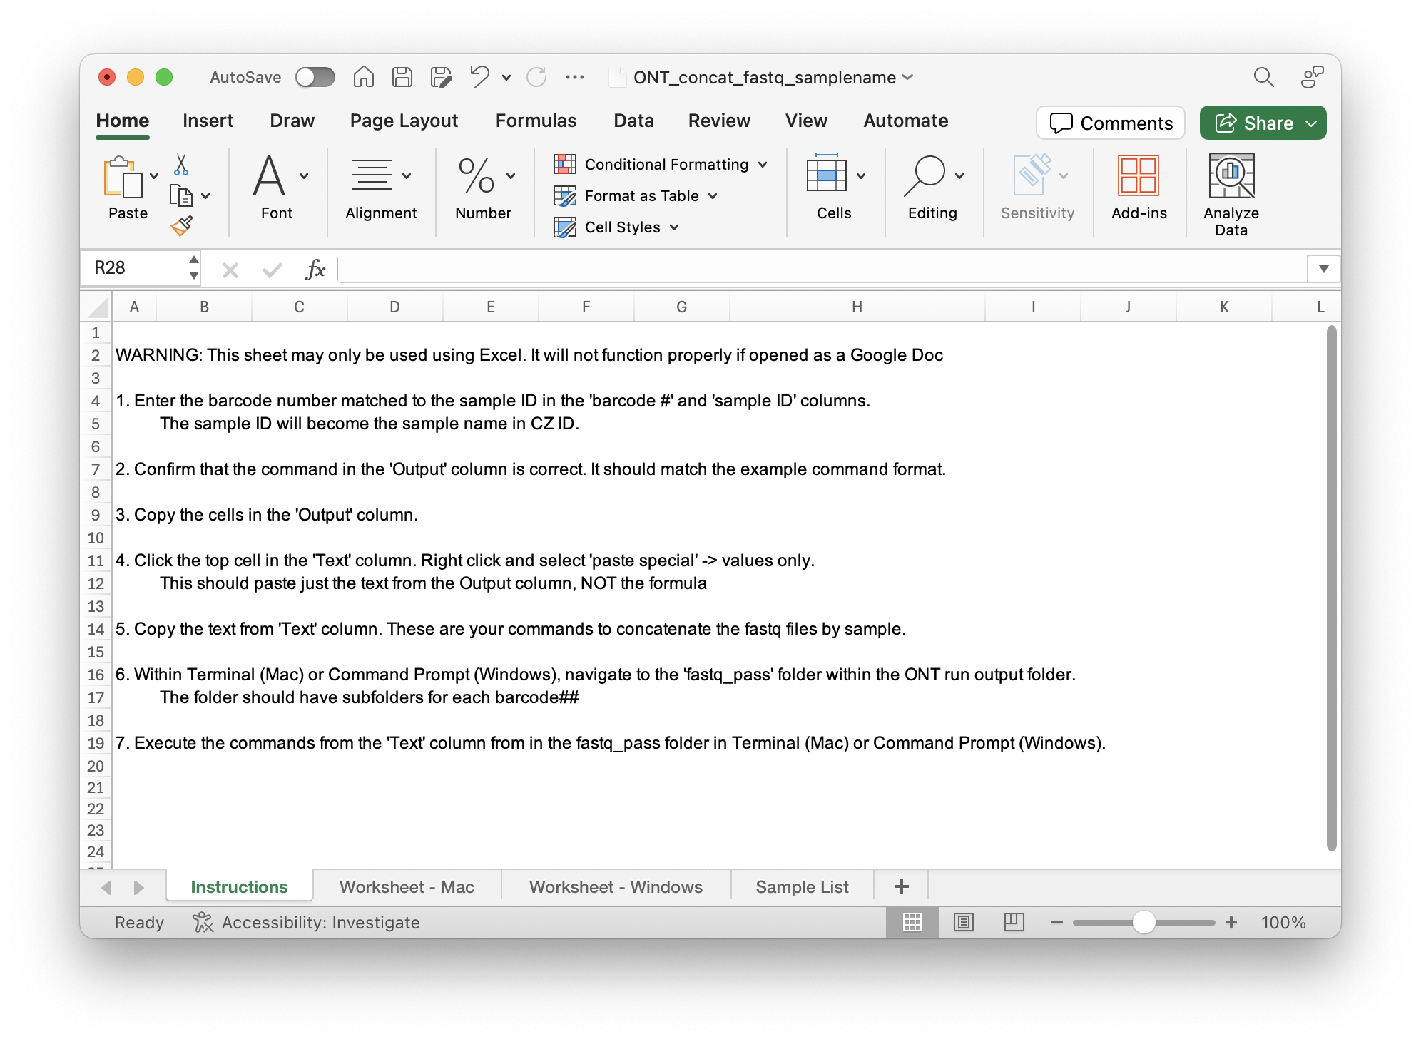
Step 1: Use worksheet to generate commands
Choose the tab for your computer type
Review instructions

Slide 14
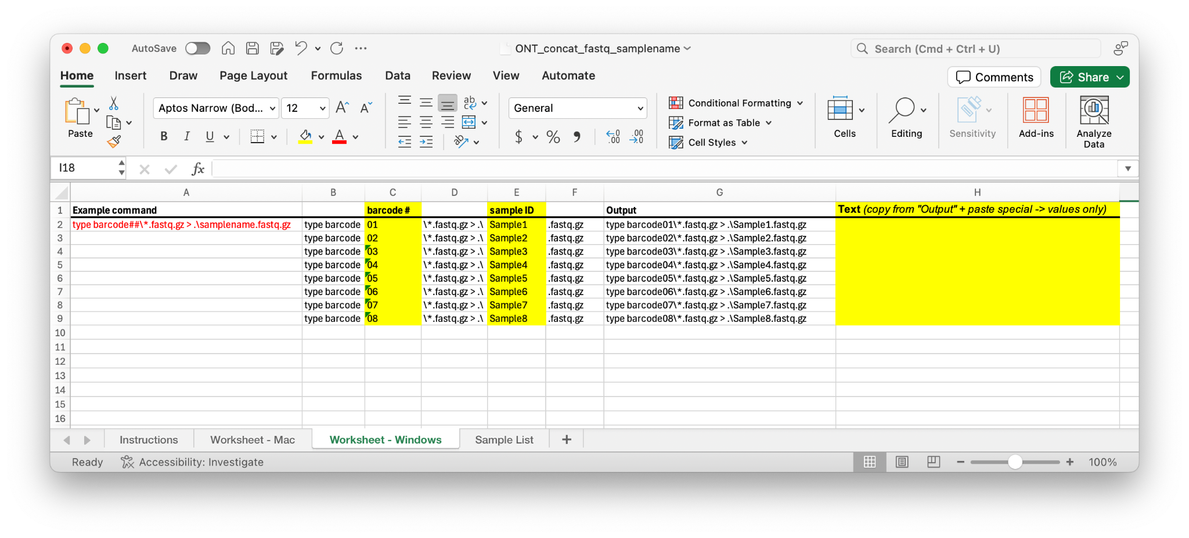
1. Enter the barcode number matched to the sample ID in the 'barcode #' and 'sample ID' columns.

Slide 15
2. Confirm that the command in the 'Output' column is correct. It should match the example command format.

Slide 16
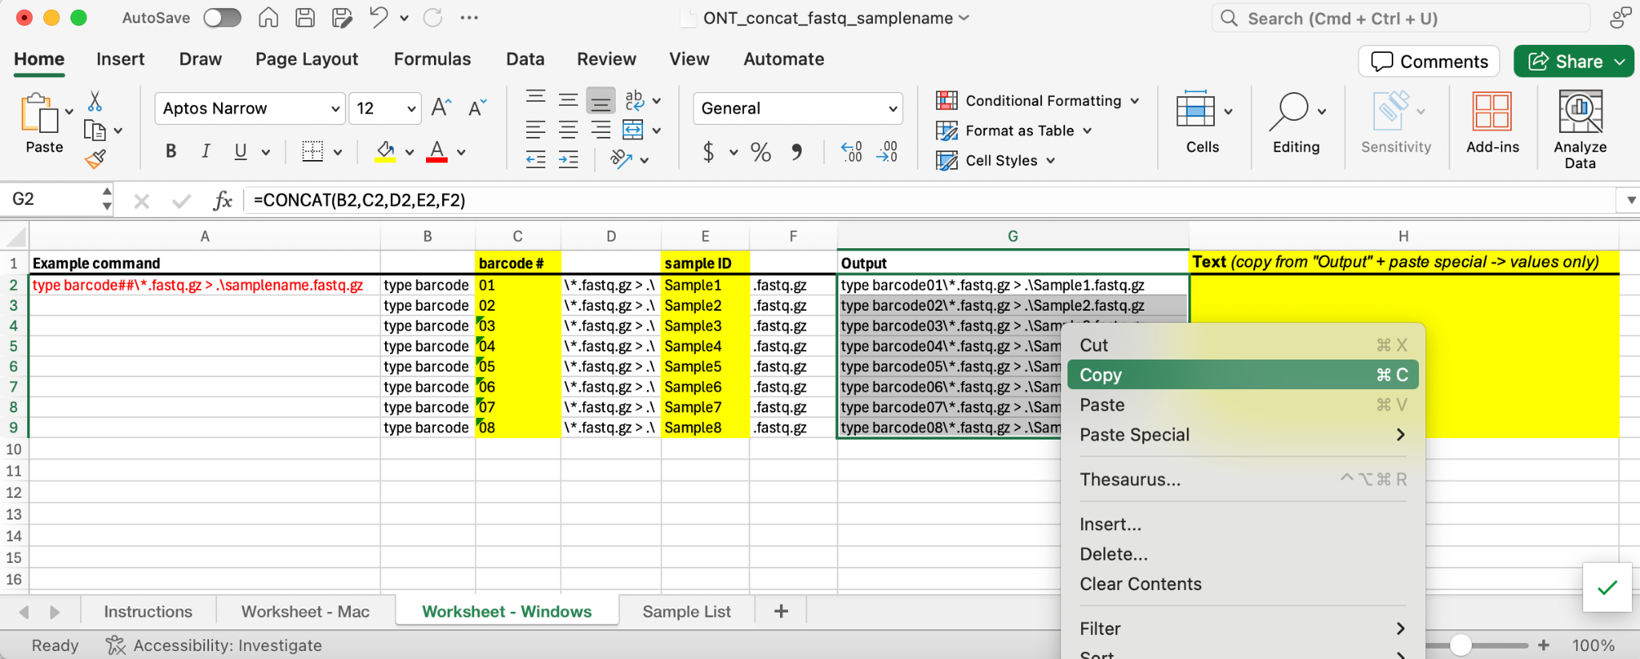
3. Copy the cells in the 'Output' column.

Slide 17
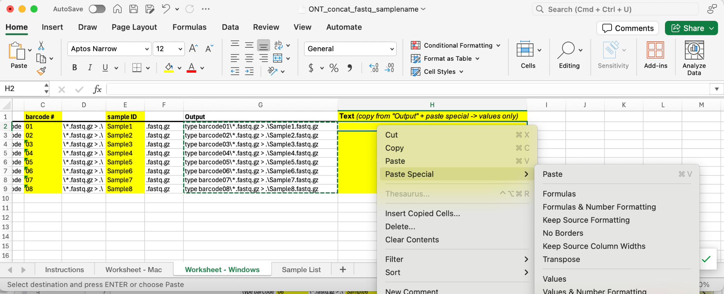
4. Click the top cell in the 'Text' column. Right click and select 'paste special' -> values only.

Slide 18
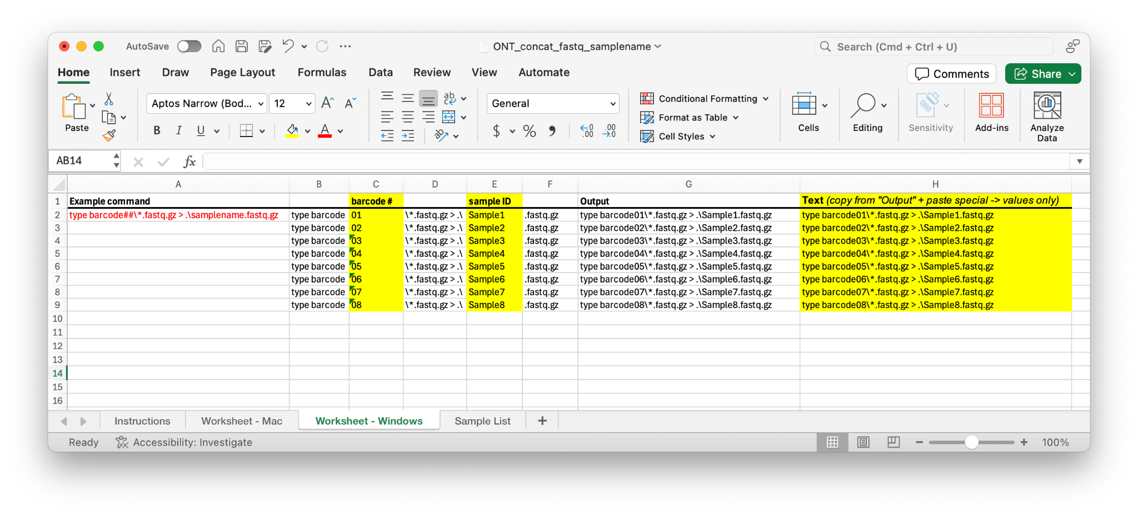
Done in excel for now…

Slide 19
Example command (windows command prompt)
type barcode##\*.fastq.gz > .\samplename.fastq.gz

Slide 20
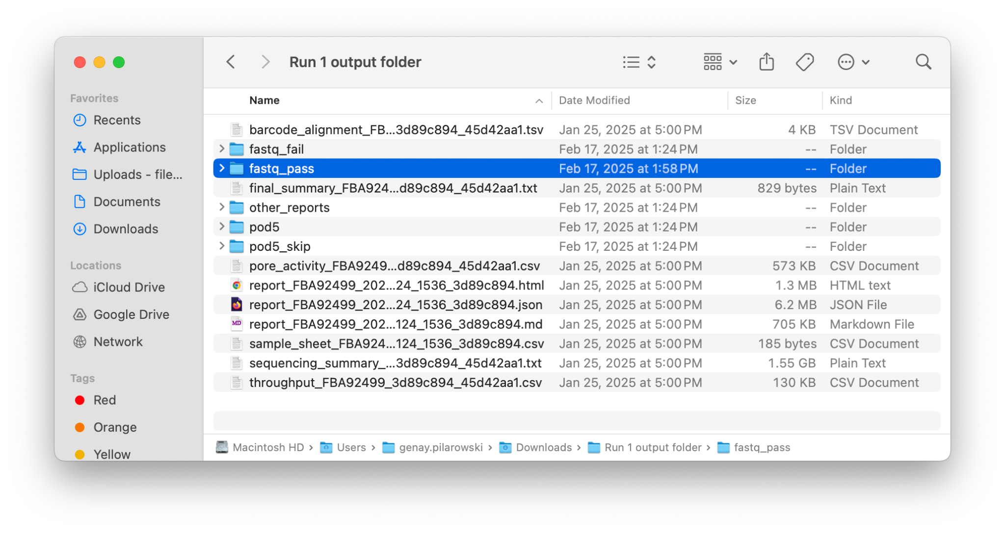
Navigate to the correct ONT run output folder and find the fastq_pass folder

Slide 21
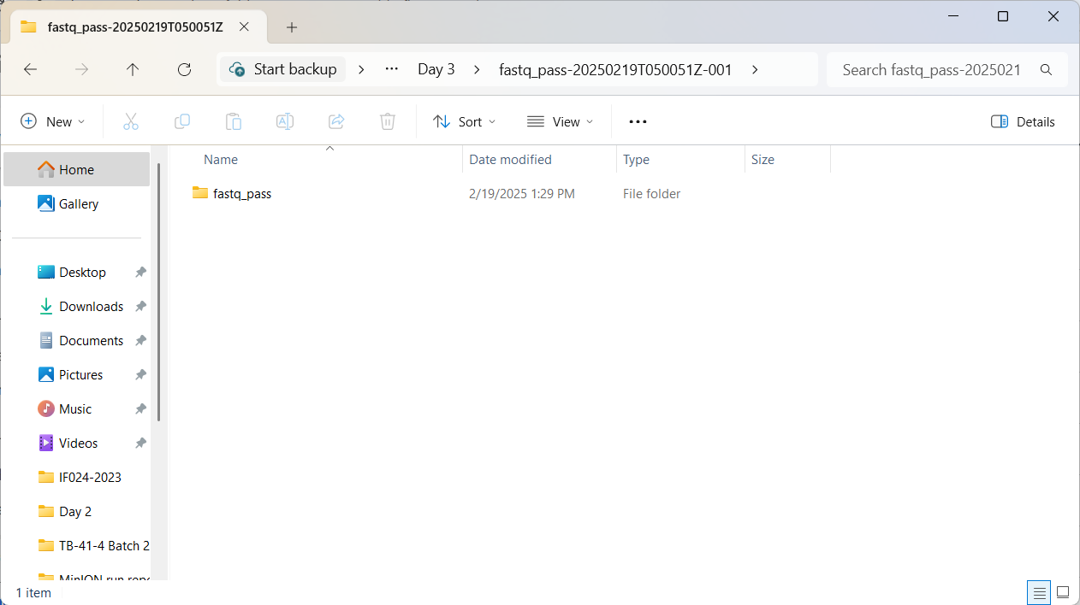
Navigate to the correct ONT run output folder and find the fastq_pass folder

Slide 22
Right click the fastq_pass folder and select “copy path”
You are copying the path (or directions) to the folder (aka directory)
It is very important you are in the correct run folder

Slide 23
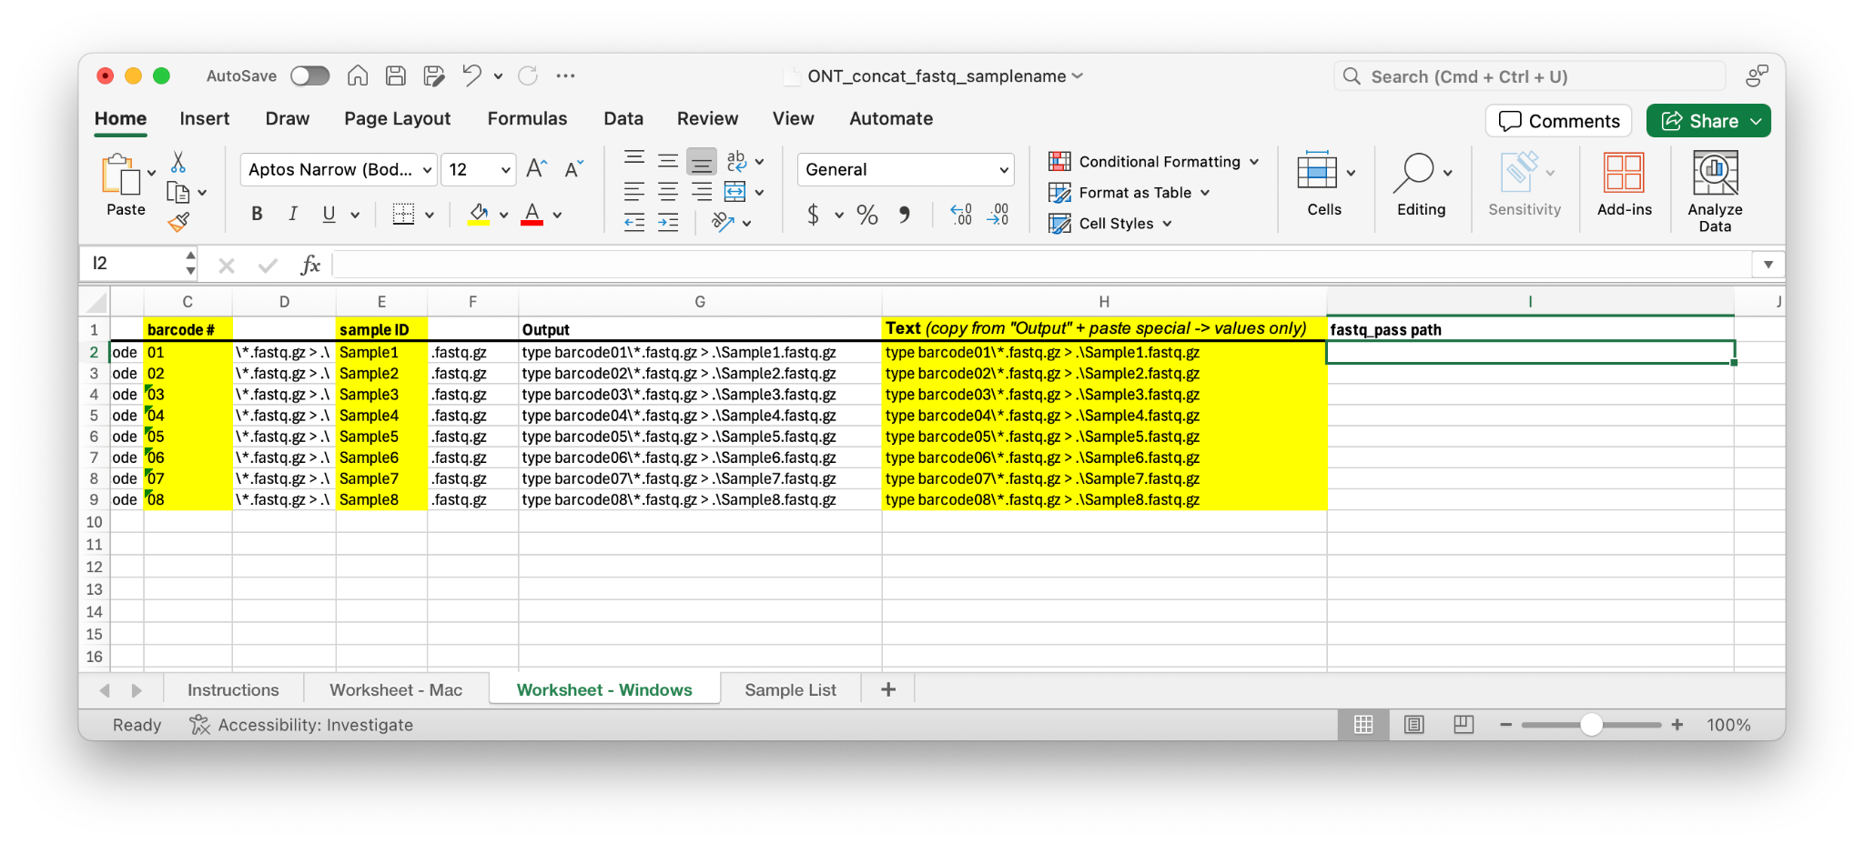
Record the fastq_pass folder path in the worksheet
This is for record-keeping purposes

Slide 24
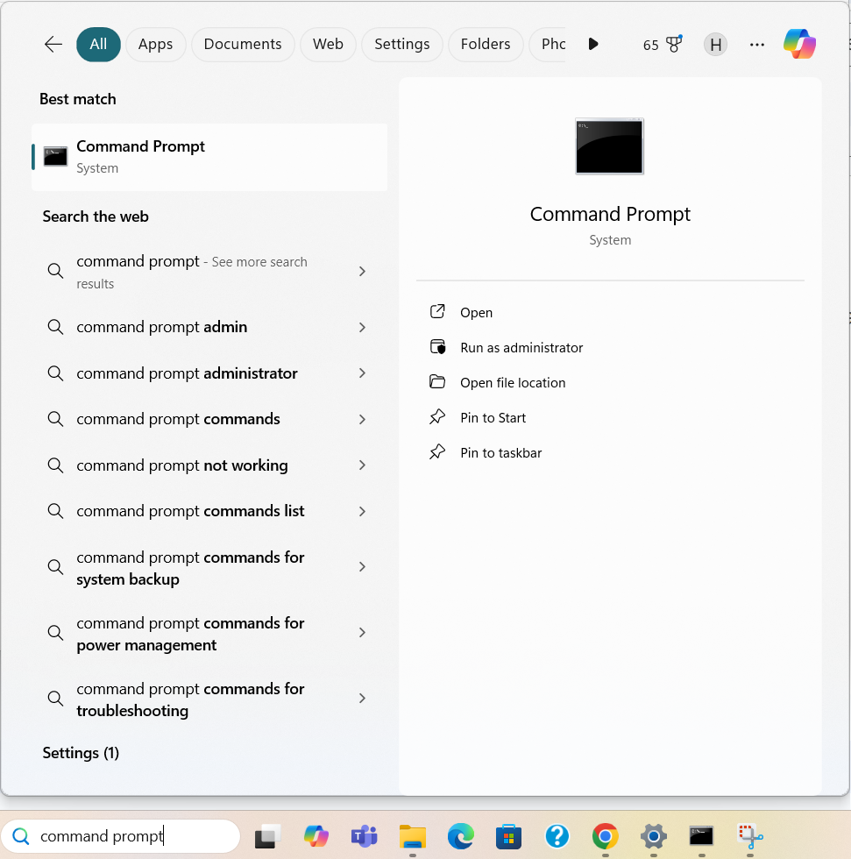
Open Command Prompt in Windows
You will navigate to the fastq_pass folder using the “path” collected in the previous step

Slide 25
Change working directory to run output / fastq_pass
In Command Prompt, type: cd
Paste the fastq_pass “path” from the worksheet
Press “Enter” on your keyboard
In command prompt, you should now be inside the fastq_pass folder. Let’s check!
In Command Prompt, type: cd
Check that the output matches your “path”
If it matches, you are ready to concatenate

Slide 26
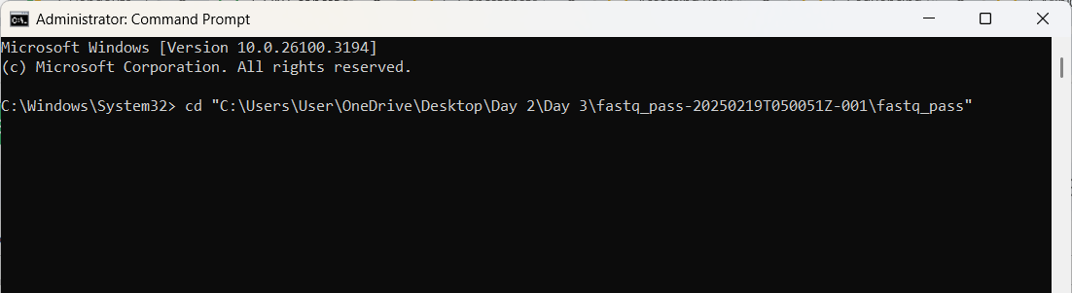
In Command Prompt, type: cd
Paste the fastq_pass “path” from the worksheet

Slide 27
In Command Prompt, type: cd
Paste the fastq_pass “path” from the worksheet
✘
Must remove quotation marks

Slide 28
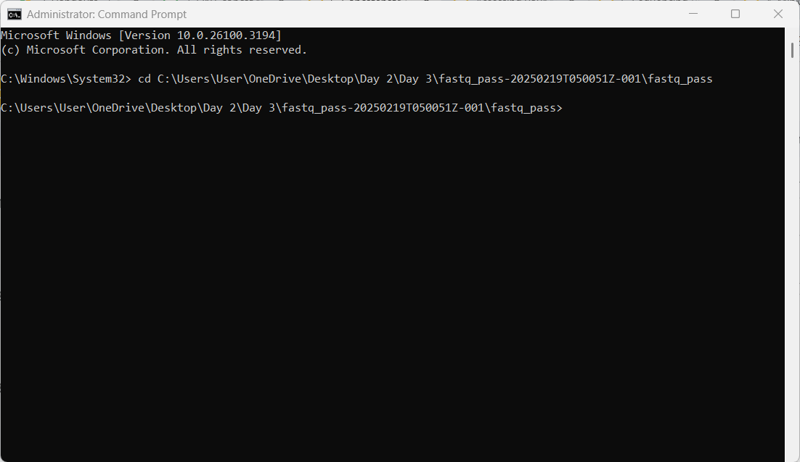
In Command Prompt, type: cd
Paste the fastq_pass “path” from the worksheet
Remove the quotation marks from around the path

Slide 29
In command prompt, you should now be inside the fastq_pass folder.

Slide 30
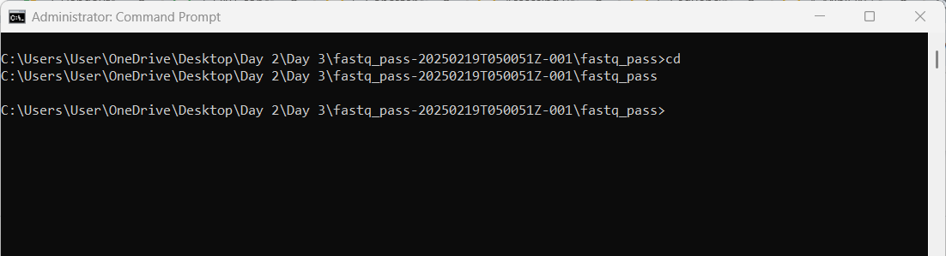
In Command Prompt, type: cd
Check that the output matches your “path”
If it matches, you are ready to concatenate
✓

Slide 31
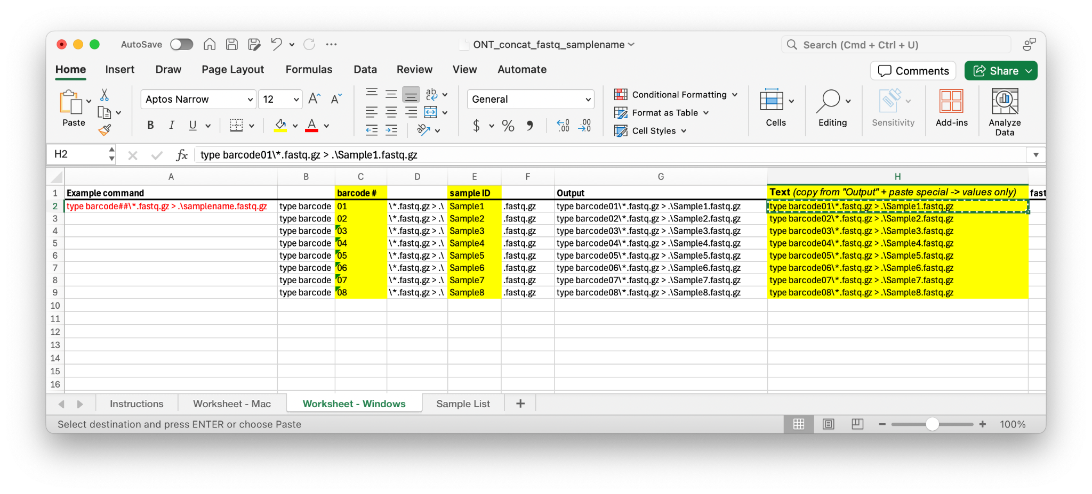
5. Copy the text from 'Text' column.
These are your commands to concatenate the fastq files by sample.

Slide 32
Run each command from the 'Text' column in Command Prompt

Slide 33
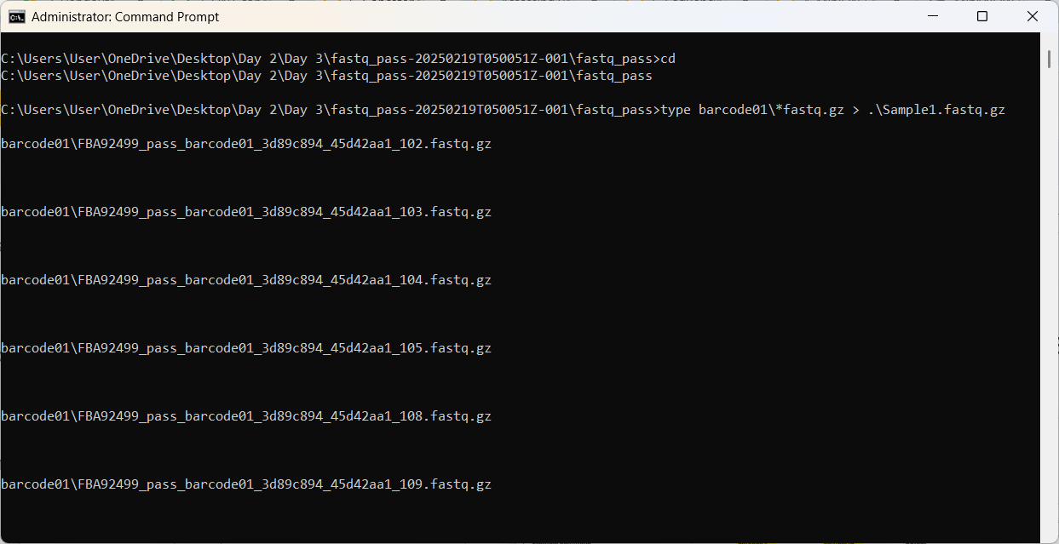

Slide 34
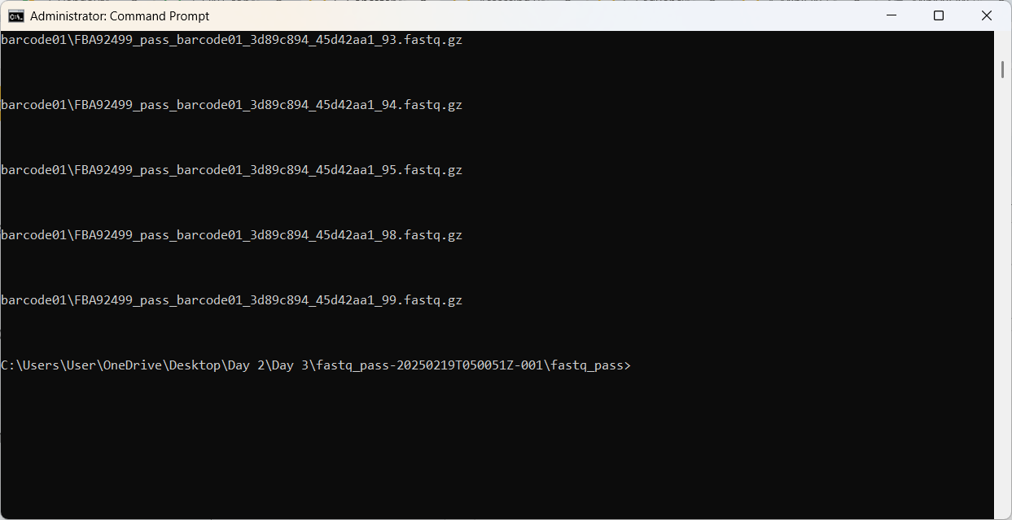

Slide 35
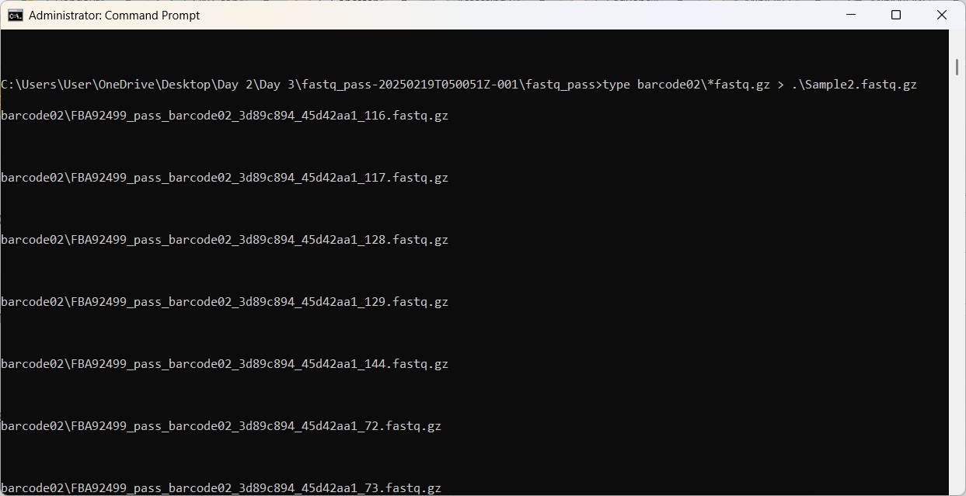

Slide 36
Check your run folder for your newly concatenated files
You should have one file for each sample, named according to the Sample ID input to the concatenation worksheet

Slide 37
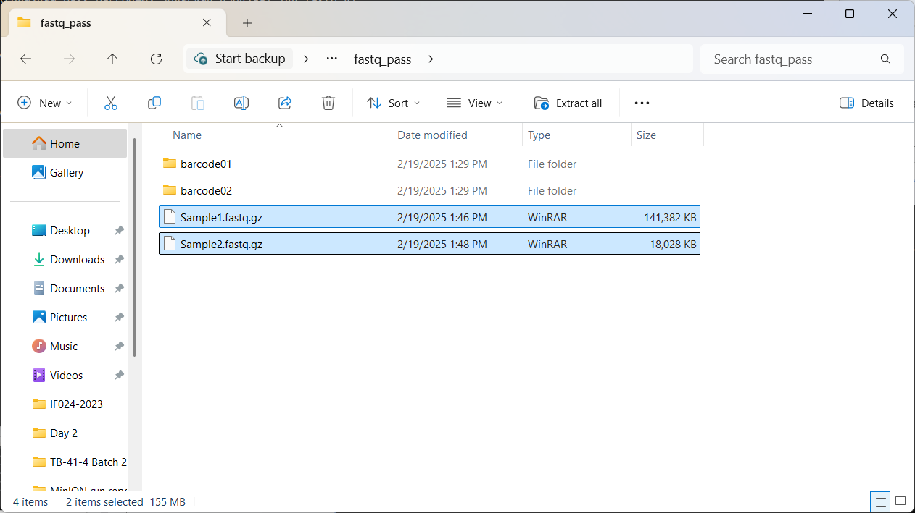

Slide 38
Let’s proceed to concatenate and barcode filter our own data!
Associated Worksheet: DL3-O_Concat fastq worksheet
Next Slides: DL4-O_CZ ID mNGS Pipeline for ONT

